Slide 1
Statement PreparedStatement and CallableStatement in Java

Slide 2

Agenda
What is Statement?
What is Prepared Statement?
What is CallableStatement?
Comparison between Statement and PreparedStatement
Practical Implementation

Slide 3
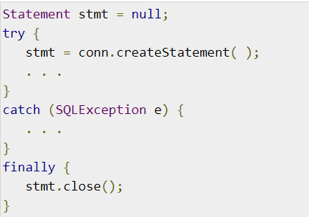
Statement
Use this for general-purpose access to your database.
Useful when you are using static SQL statements at runtime.
The Statement interface cannot accept parameters.
The important methods of Statement interface:
stmt.executeUpdate(String sql)
stmt.exceuteQuery(String sql)

Slide 4
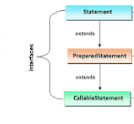
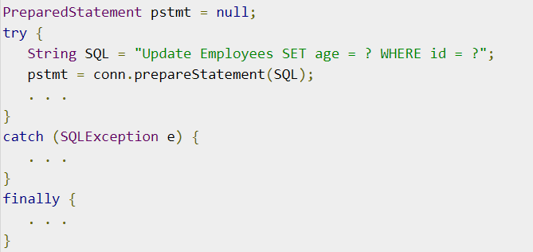
PreparedStatement
Use this when you plan to use the SQL statements many times.
The PreparedStatement interface accepts input parameters at runtime.
public void setString(int paramIndex, String value)
public void setInt(int paramIndex, int value)

Slide 5
CallableStatement
It is an interface in JDBC API which is used to call the stored procedures form the Java code. CallableStatement extends PreparedStatement which in turn extends Statement.
What is stored procedure?
Stored procedure is a set of SQL statements to be executed to perform a specific task on a database.
Stored procedures are precompiled and stored in the database.
Like dynamic SQL queries , you can pass the parameters to stored procedures. Stored procedures take 3 types of parameters.
IN Parameter(Default)
OUT Parameter
IN OUT Parameter

Slide 6
Difference between Statement and PreparedStatement
Statement
PreparedStatement
It is used to execute normal SQL queries.
It is preferred when a particular SQL query is to be executed only once.
You cannot pass the parameters to SQL query using this interface.
This interface is mainly used for DDL statements like CREATE,ALTER,DROP etc.
The performance of this interface is very low.
It is used to execute parameterized or dynamic SQL queries.
It is preferred when a particular query is to be executed multiple times.
You can pass the parameters to SQL query at run time using this interface.
It is used for any kind of SQL queries which are to executed multiple times.
The performance of this interface is better than the Statement Interface.

Slide 7




Thank you

